Slide 1
companies with more than $1B in cash have significantly higher returns in average, compared to companies that have less than $1B by the end of the year.
GAUKHAR JAVAROVA

Slide 2
agenda
Introduction of the data.
Is there a significant difference in returns?
How much is the difference in returns?
What’s the use of the hypothesis?
Conclusion.

Slide 3
Data
1340 companies’ returns from the end of the Q1 2018 to the end of Q1 2019
Data includes ticker name, price, cash/assets, calendar date.
Raw data can be found here: Quandl.com

Slide 4
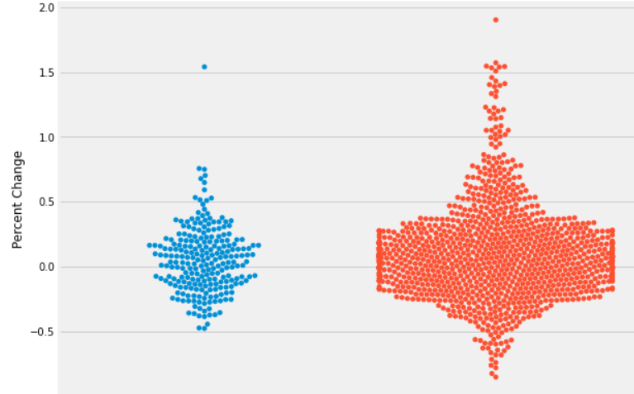
Is there a significant difference?
More than$1B
Less than$1B
237 companies
1103 companies

Slide 5
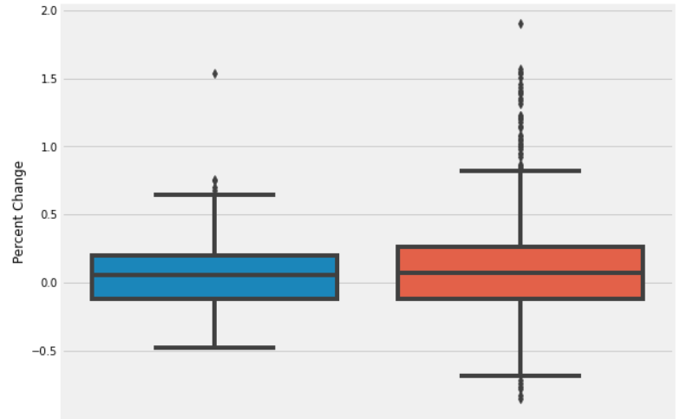
By how much is the difference in returns?
The mean return difference is 5% -/+4% with a 95% confidence level.
The confidence interval is +4%.
Cash rich companies
Cash weak companies

Slide 6
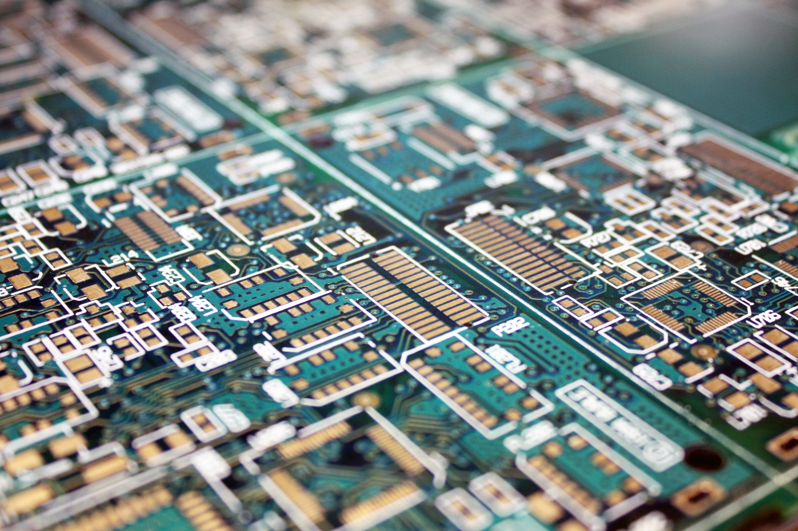

What’s the use of this information?
‘Cash rich’ AMD made > 150%
Great valuable, stable stock for long term hold
‘Cash weak’ GLUU made > 190%
This is a low risk / high reward stock
Cash weak GLUU performed better than cash rich AMD.

Slide 7
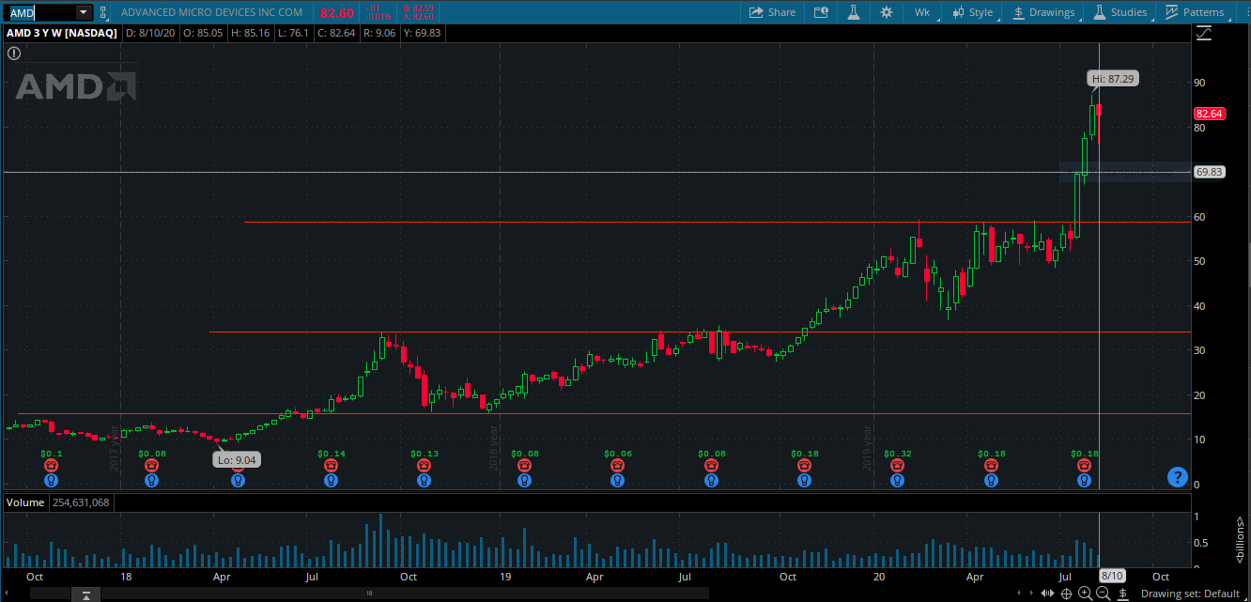
Best performer from the cash rich companies: AMD made >150%
Q2019
Q2018

Slide 8
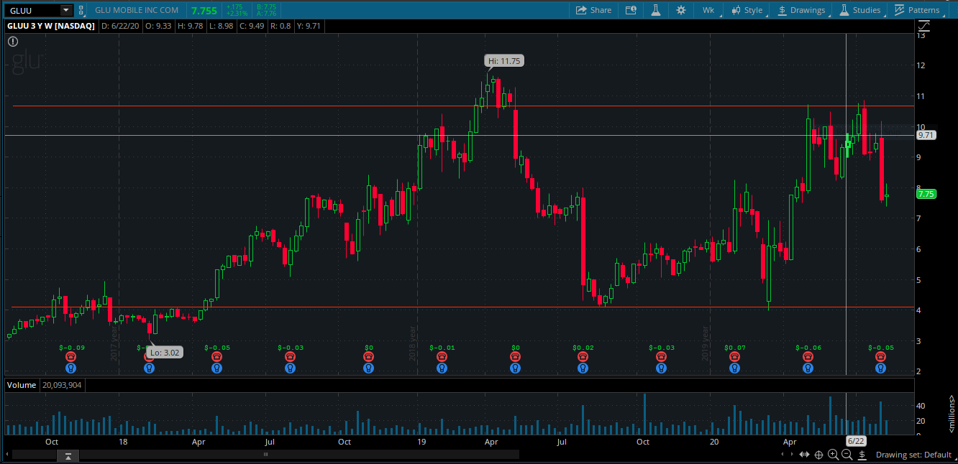
Best performer from the cash weak companies Gluu >190%
Q2019
Q2018

Slide 9
Conclusion
The null hypothesis was rejected: companies with more than $1B in cash have significantly higher returns in average, compared to companies that have less than $1B by the end of the year.
The alternative hypothesis was accepted: companies with less than $1B in cash have significantly higher returns in average, compared to companies that have more than $1B by the end of the year.

Slide 10
Questions?
THANK YOU!

